Slide 1

Sigma
To what extent is designing and creating a social media app in Visual Studio difficult for a person with prior experience with coding in Python and SQL?

Slide 2
Why I did an EPQ
Pre-existing love for computer science
Wanted to learn C#
Good opportunity for experience with software development
Want to pursue computing at uni and further on in a career
Having full control over my project

Slide 3
MY TOPIC TITLE

Slide 4
To what extent is designing and creating a social media app in Visual Studio difficult for a person with prior experience with coding in Python and SQL?
Is creating a 3D FPS game in Unity Difficult?

Slide 5
To what extent is designing and creating a social media app in Visual Studio difficult for a person with prior experience with coding in Python and SQL?
Is creating a 3D FPS game in Unity Difficult?
Is creating a social media app in visual studio difficult?

Slide 6
To what extent is designing and creating a social media app in Visual Studio difficult for a person with prior experience with coding in Python and SQL?
Is creating a 3D FPS game in Unity Difficult?
Is creating a social media app in visual studio difficult?
To what extent is creating a social media app difficult?

Slide 7
To what extent is designing and creating a social media app in Visual Studio difficult for a person with prior experience with coding in Python and SQL?
Is creating a 3D FPS game in Unity Difficult?
Is creating a social media app in visual studio difficult?
To what extent is creating a social media app difficult?
To what extent is designing and creating a social media app in Visual Studio difficult?

Slide 8
To what extent is designing and creating a social media app in Visual Studio difficult for a person with prior experience with coding in Python and SQL?
Is creating a 3D FPS game in Unity Difficult?
Is creating a social media app in visual studio difficult?
To what extent is creating a social media app difficult?
To what extent is designing and creating a social media app in Visual Studio difficult?
To what extent is designing and creating a social media app in Visual Studio difficult for a person with prior experience with coding in Python and SQL?

Slide 9
My Sources

Slide 10
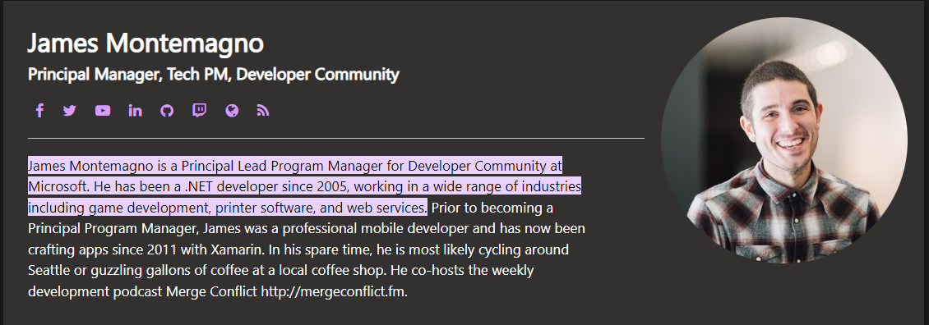
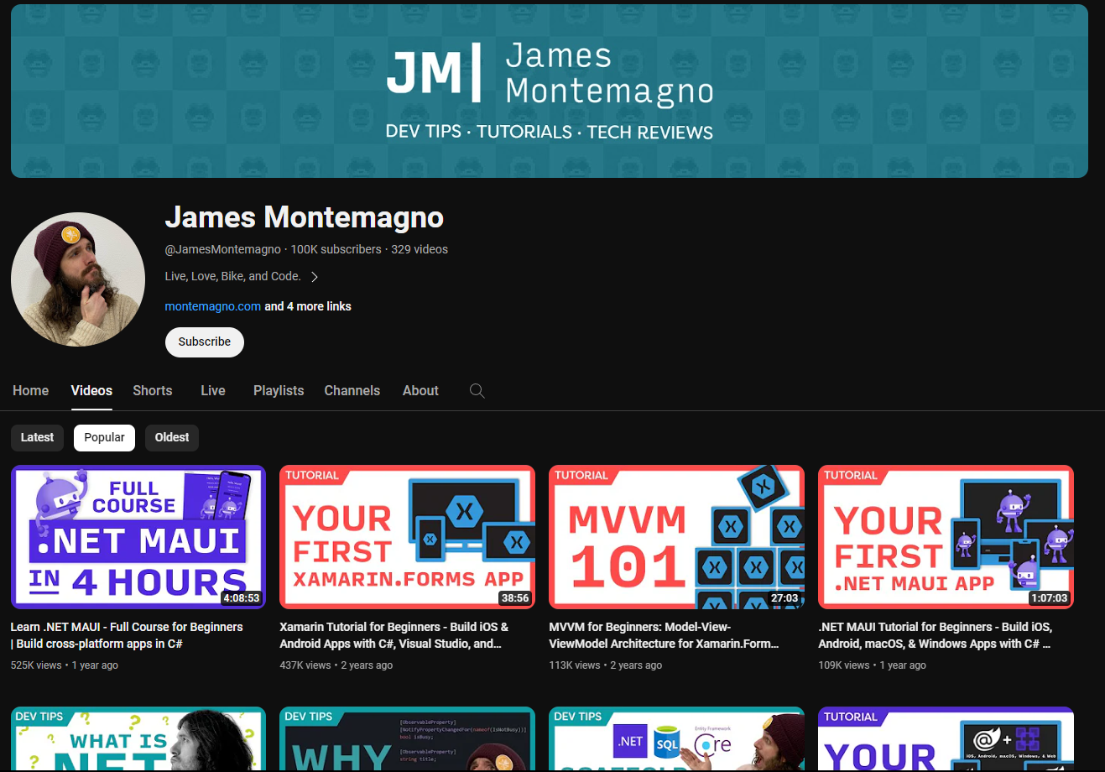

Slide 11
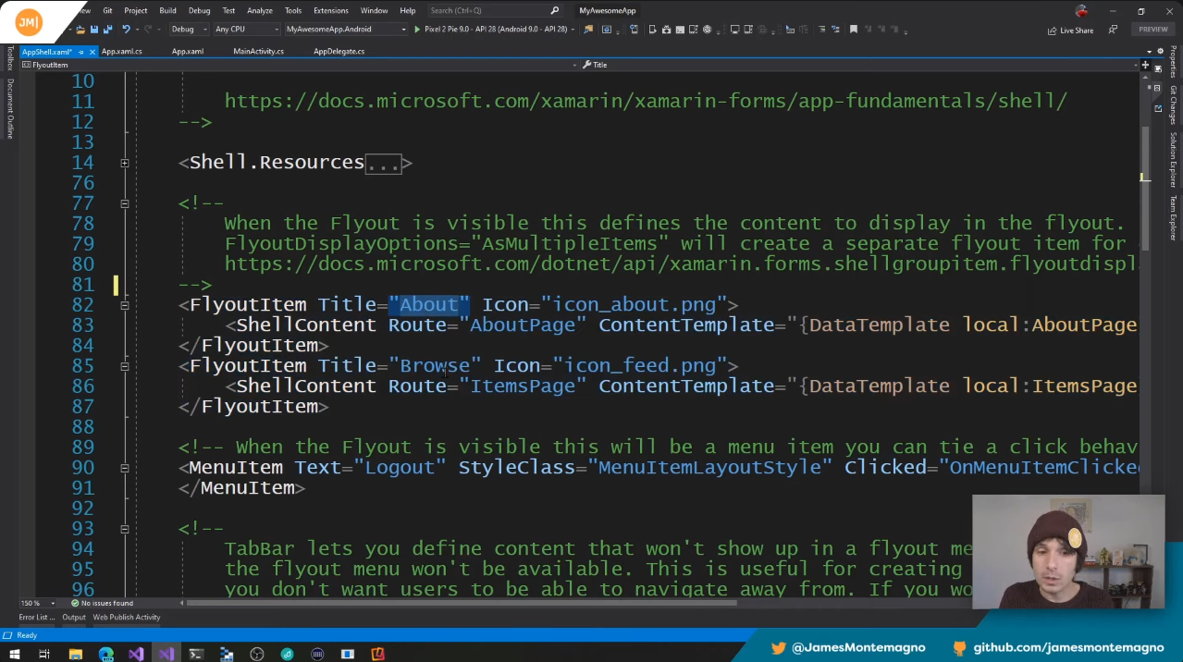
James Montemagno
Past Developer at Microsoft ( Creators of Xamarin and Visual studio)
Shows working examples
Explains in depth

Slide 12

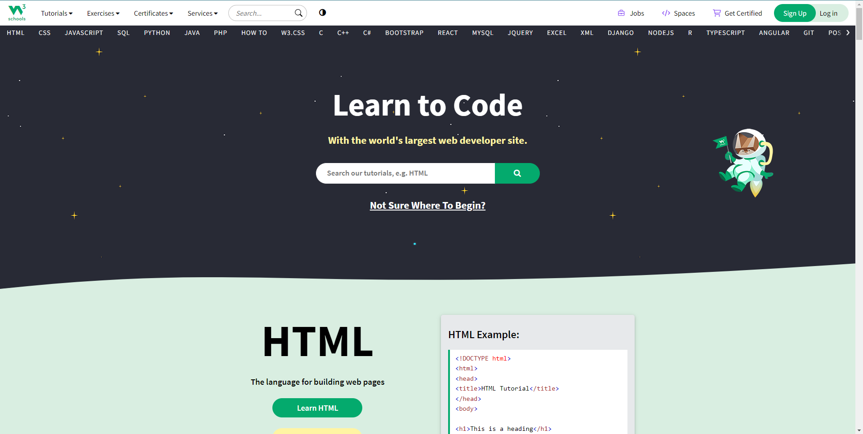

Slide 13
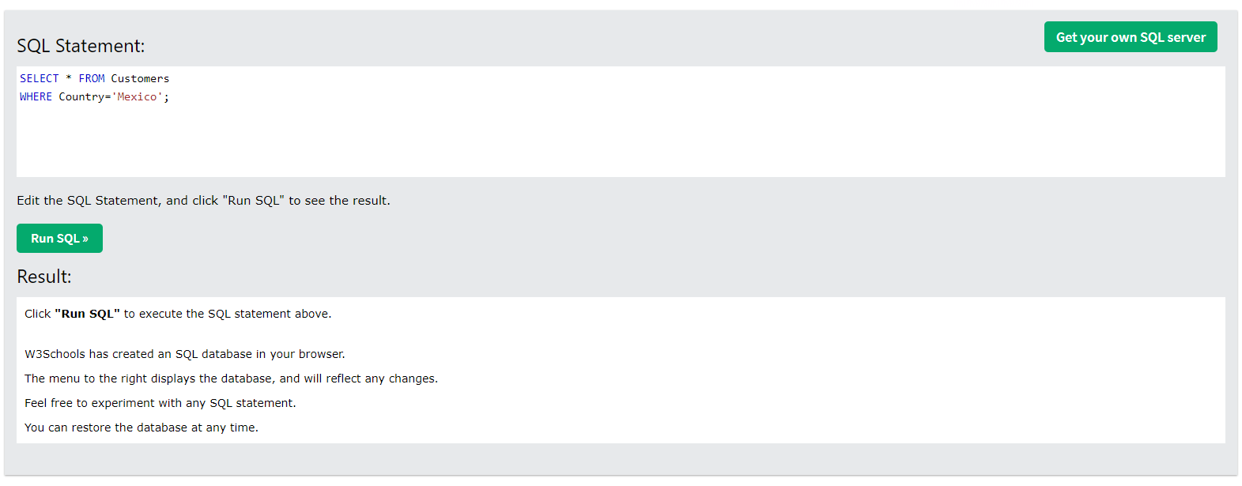
W3 Schools
Easy to use and learn from
Shows working and interactive examples
Good Explanations
Trusted by our school

Slide 14
Sigma

Slide 15
How an app works.

Slide 16
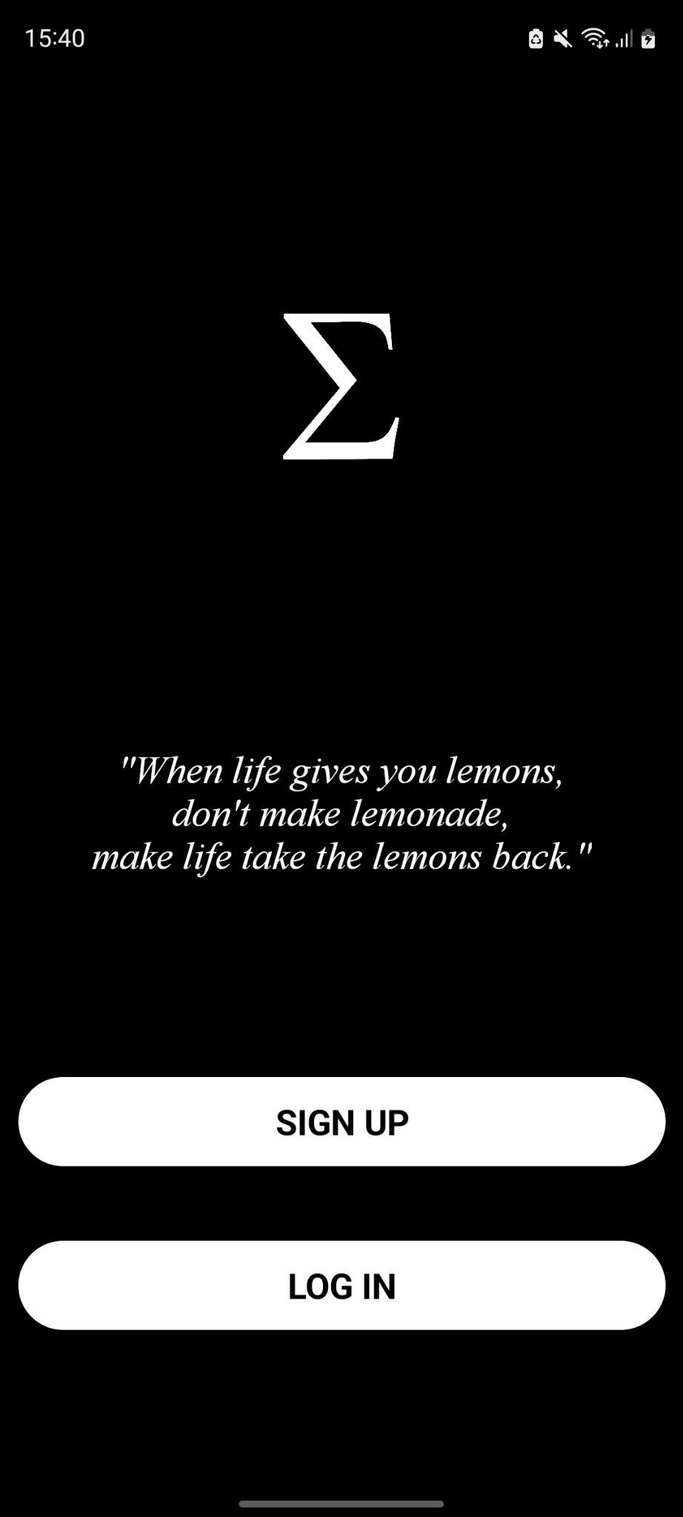

How an app works.
User
Frontend

Slide 17
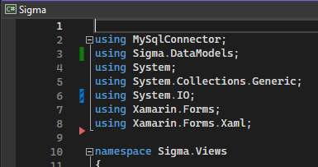
How an app works.
User
Frontend
Backend

Slide 18
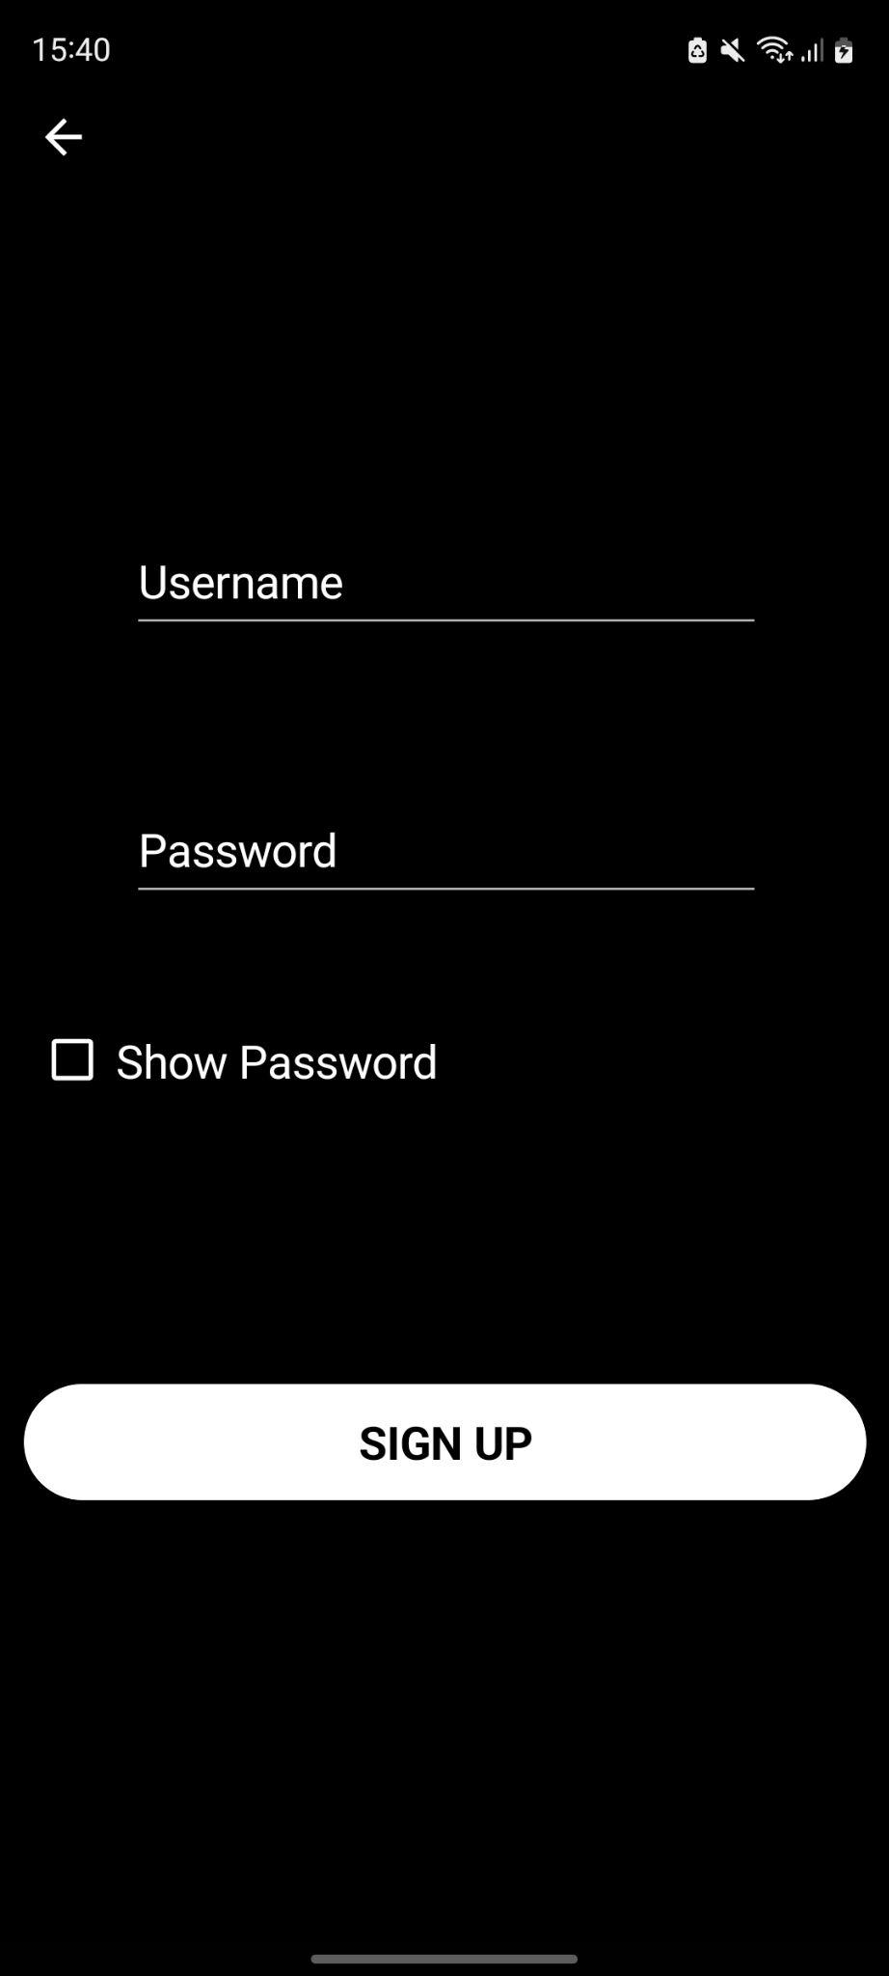
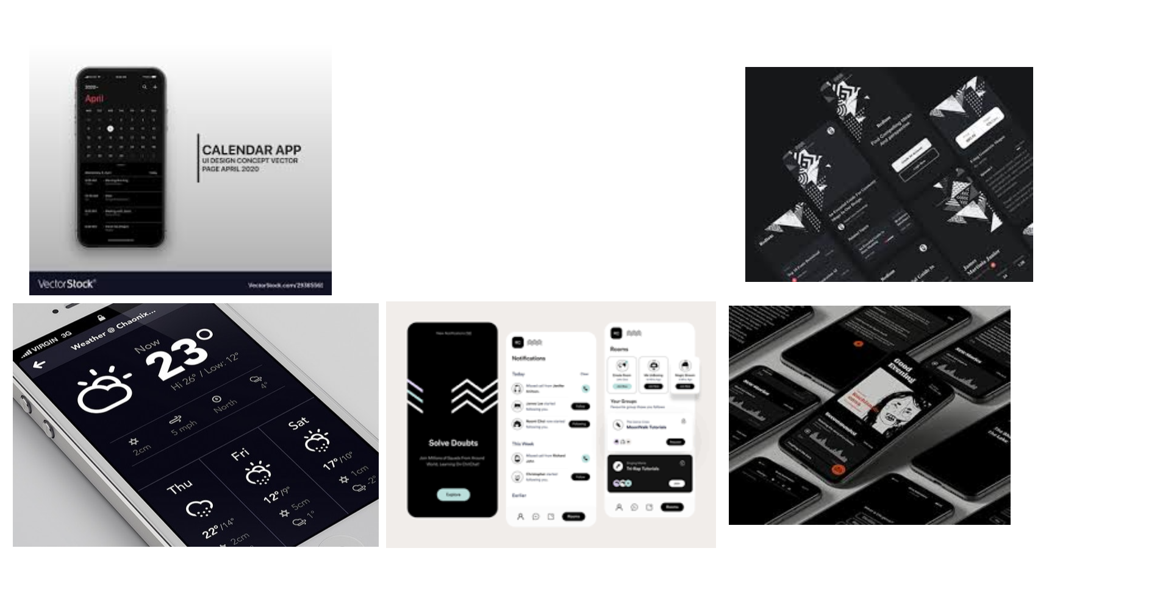
Frontend
The UI must look clean and not overcrowded
It must be easy to navigate
It should follow a specific style and stay consistent

Slide 19
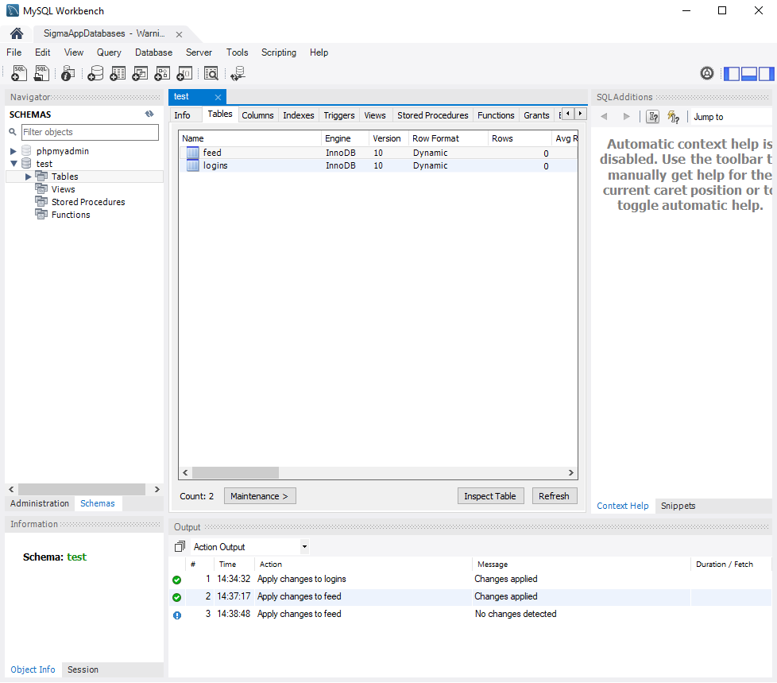
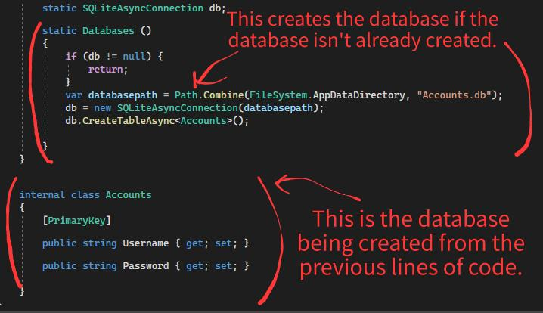
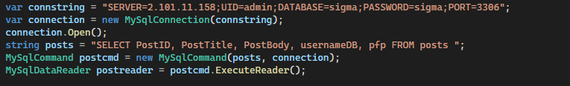
Backend
Did the app work as intended?

Slide 20
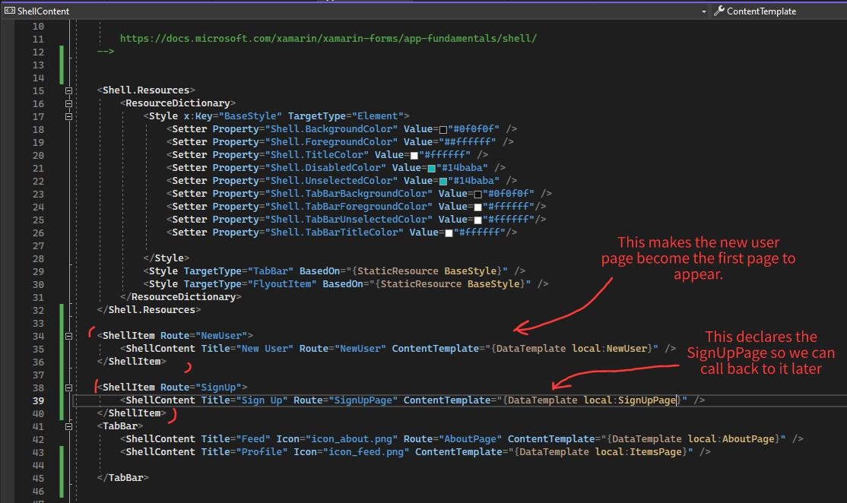
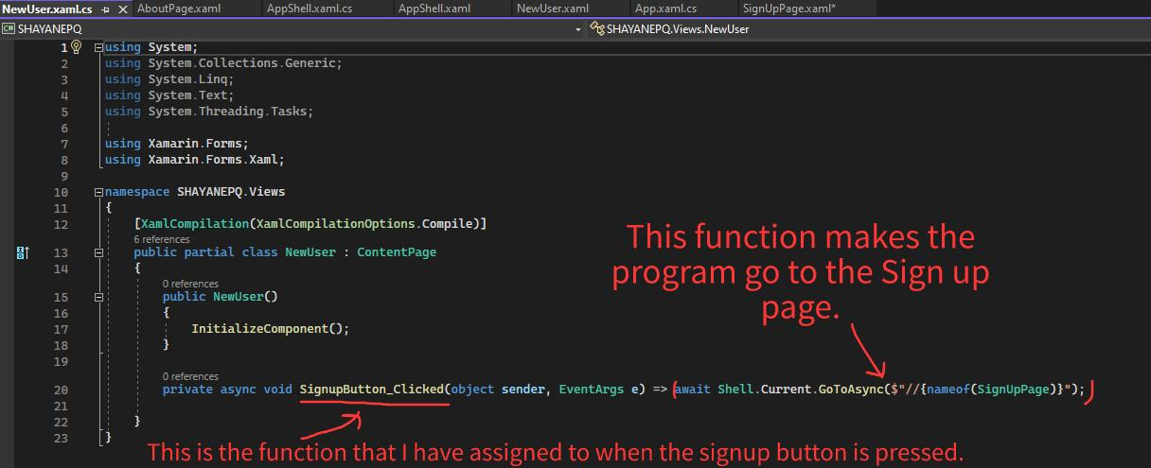
Frontend code vs Backend code

Slide 21
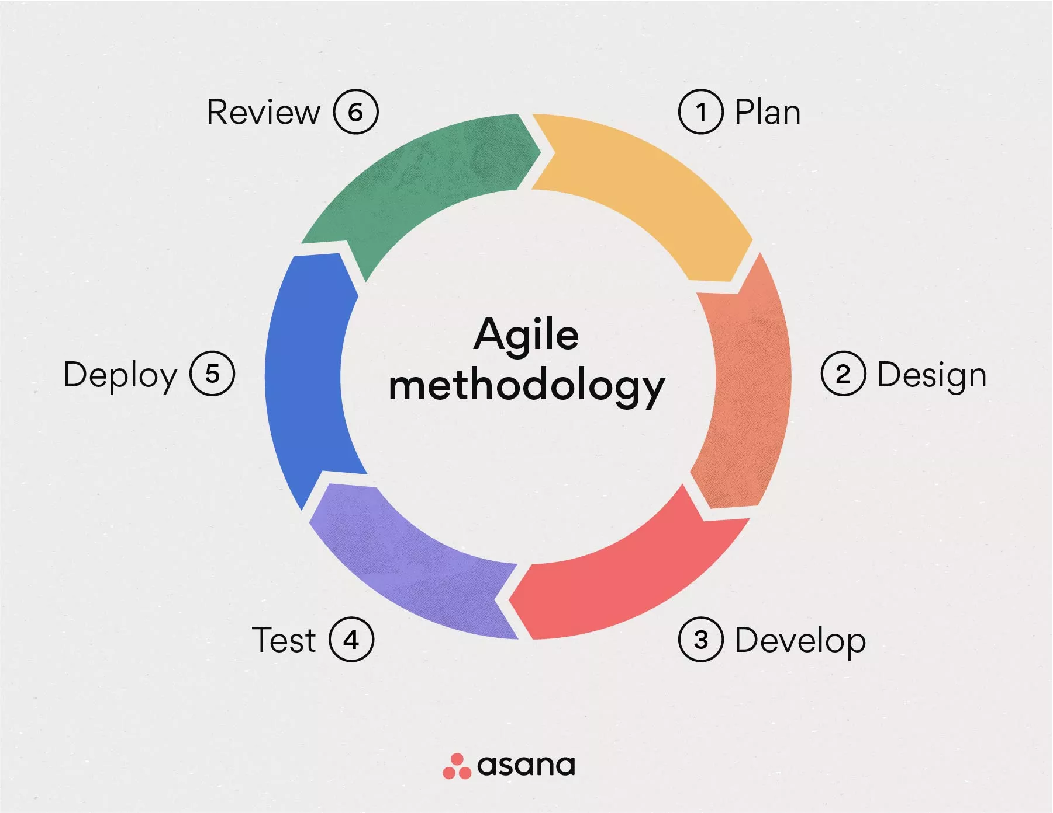
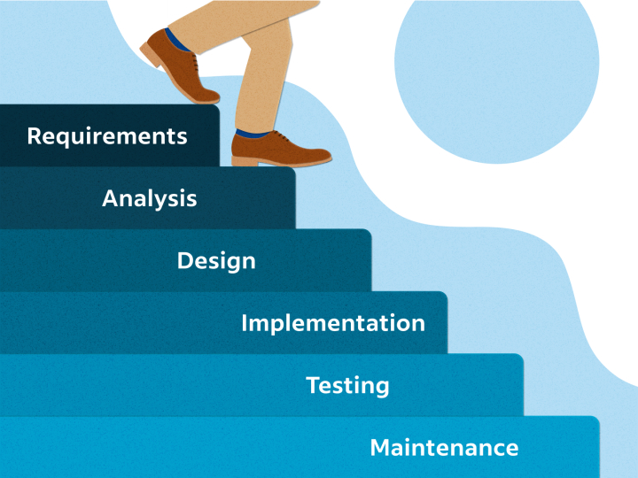
Methodology
Waterfall
Agile

Slide 22
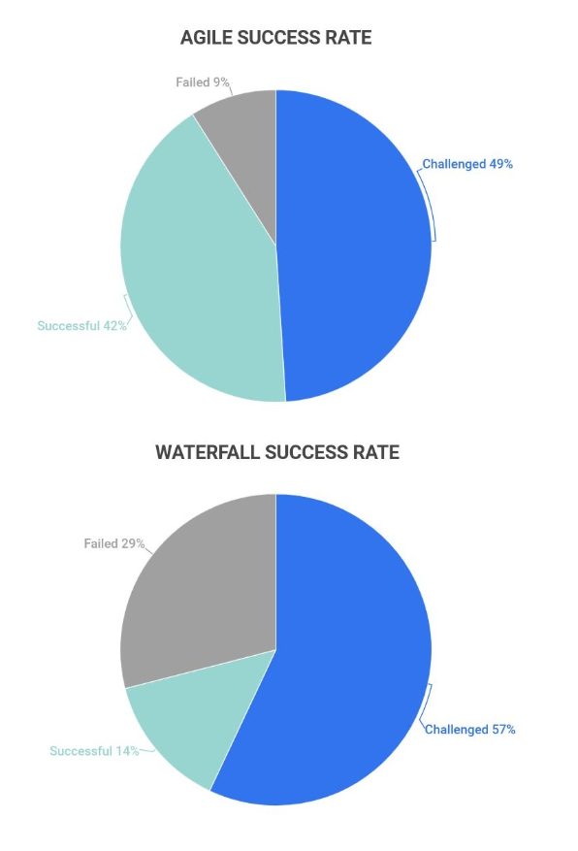
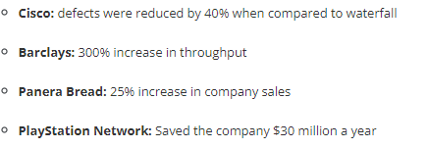
Why I chose Agile
Iterative and therefore allowing for a more complete final product
Better for producing a product in shorter time spans
Much more flexible
https://www.zippia.com/advice/agile-statistics/

Slide 23
Divide and conquer
App
New User
Feed
Create
Search
Profile

Slide 24
Divide and conquer
New User
Feed
Create
Search
Profile
Post contents
Posts
Profile Details
Login
Posts
Log out
Sign in
Comments
Post function
Comments
Welcome
Search Bar
Profile Posts

Slide 25
Basic Components
UI
UI Functionality
Database

Slide 26
Basic Components
UI
UI Functionality
Database
Least Difficult
Most Difficult

Slide 27
Oct
2022
P1
March
2023
Aug
2023
P3
Sep
2023
P2

Slide 28
UI
Oct
2022
P1
March
2023
Aug
2023
P3
Sep
2023
P2

Slide 29
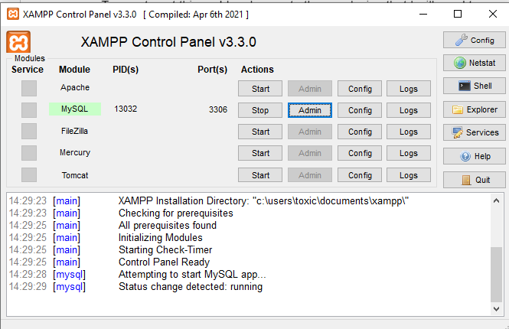
UI
Database
Oct
2022
P1
March
2023
Aug
2023
P3
Sep
2023
P2

Slide 30
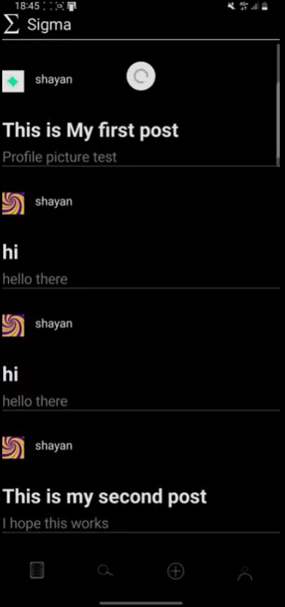
Finishing Up
UI
Database
Oct
2022
P1
March
2023
Aug
2023
P3
Sep
2023
P2

Slide 31
Prototype 1
Learnt to create UI components
Learnt to add functionality to the UI
Created a Login UI
Created a Local Database

Slide 32
Prototype 1
Learnt to create UI components
Learnt to add functionality to the UI
Created a Login UI
Created a Local Database

Slide 33
Local Database Problem

Slide 34
Local Database Problem
Post 0

Slide 35
Local Database Problem
Post 1
Post 0
Post 0

Slide 36
Local Database Problem
Post 1
Post 0
Post 0
Post 0

Slide 37
Online Database Server
Database Server

Slide 38
Online Database Server
Database Server
Post 0

Slide 39
Online Database Server
Post 0
Database Server
Post 0
Post 1
Post 0
Post 0

Slide 40
Online Database Server
Post 1
Post 0
Database Server
Post 1
Post 0
Post 1
Post 1
Post 0
Post 0

Slide 41
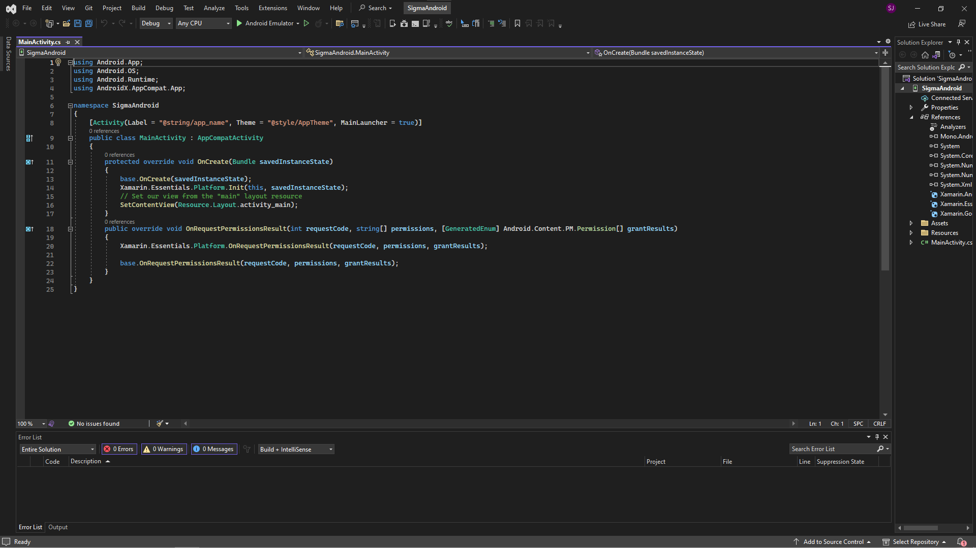
Prototype 2
Learnt to create Online Database
Created online database server
Tried connecting
Troubleshooting

Slide 42
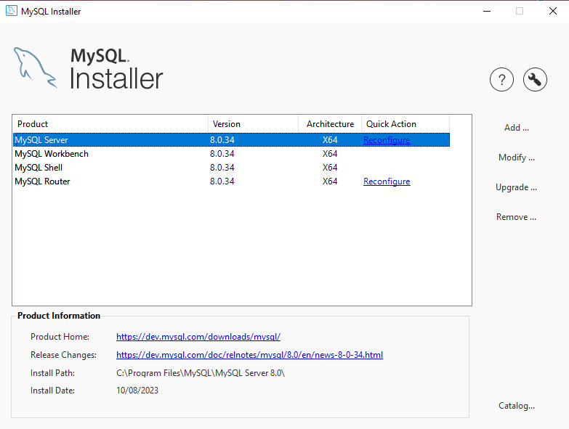
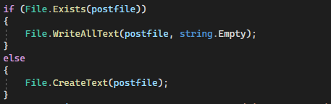
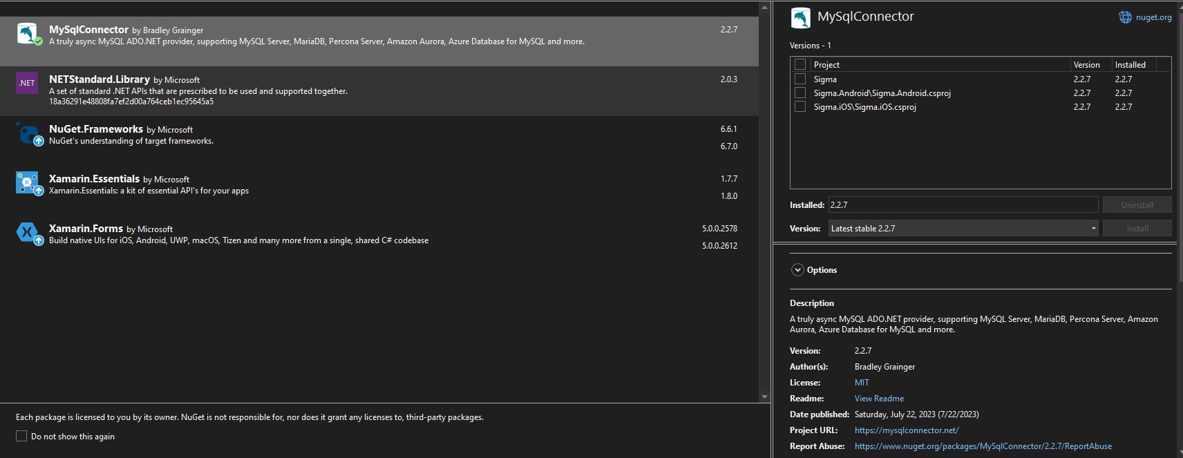
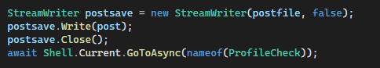
Prototype 3
New database host
New sql connecting library
New file handling
Finished the app

Slide 43
TESTING
AND EVALUATION

Slide 44
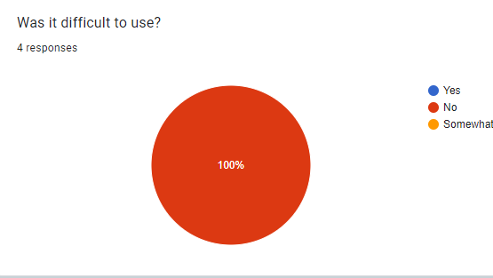
What went well
Colour theme
UI was simple and professional
Ran smoothly
Format
Quick speed response
Easy to use

Slide 45
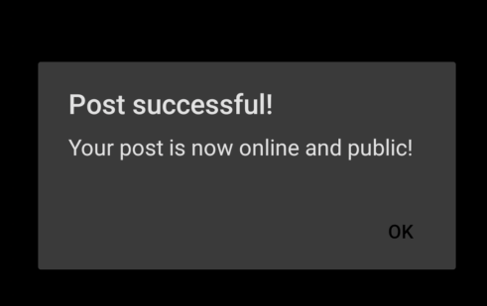

What did not go as well
Page icons are hard to see in certain light conditions
Lack of colour
Odd colour of notification box
Crashes
Format error for some phones

Slide 46
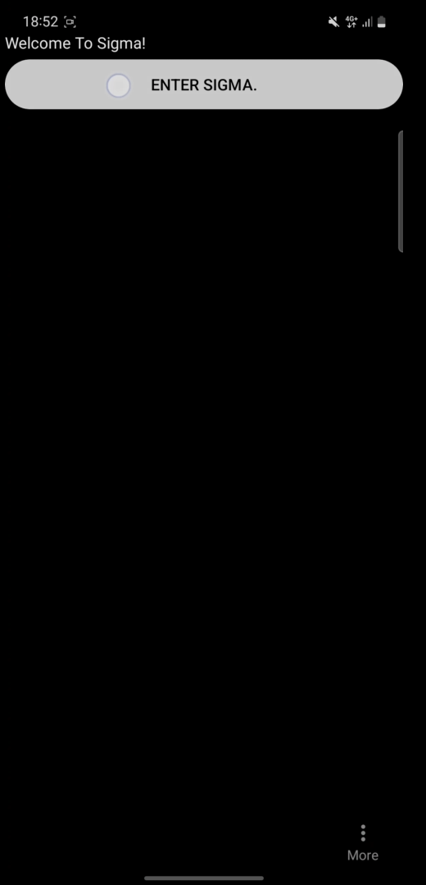
What I would do differently
Add vibrant colour to some buttons
Add likes and follows
Add tags
Fix welcome page
Brighter Icons
Fix notification colours
Niche my app

Slide 47
What I would do differently
Research UI
Code UI
Research UI Functionality
old
Code UI Functionality
Research Database
Create Database

Slide 48
What I would do differently
Research UI
Research UI
Code UI
Research UI Functionality
New
Research UI Functionality
Old
Research Database
Code UI Functionality
Code Fundamental Components
Research Database
Create app
Create Database

Slide 49
To conclude
To what extent is designing and creating a social media app in Visual Studio difficult for a person with prior experience with coding in Python and SQL?

Slide 50
To conclude
Design
Easiest part of the project
Solid idea from the beginning

Slide 51
To conclude
Design
Easiest part of the project
Solid idea from the beginning
Set up
Very Easy
Incompatible software
Have to learn layout of software

Slide 52
To conclude
Design
Easiest part of the project
Solid idea from the beginning
Set up
Very Easy
Incompatible software
Have to learn layout of software
UI
Relatively Easy
Have to learn the functions
Some errors but with easy solutions

Slide 53
To conclude
Design
Easiest part of the project
Solid idea from the beginning
UI Functionality
Difficult
A Lot more to learn compared to UI
More logic errors
Set up
Very Easy
Incompatible software
Have to learn layout of software
UI
Relatively Easy
Have to learn the functions
Some errors but with easy solutions

Slide 54
To conclude
Design
Easiest part of the project
Solid idea from the beginning
UI Functionality
Difficult
A Lot more to learn compared to UI
More logic errors
Set up
Very Easy
Incompatible software
Have to learn layout of software
Database
Extremely Difficult
Much more complex due to online functionality
More susceptible to logic and syntax errors
External Errors
UI
Relatively Easy
Have to learn the functions
Some errors but with easy solutions

Slide 55
To conclude
Overall
Quite difficult
Takes time learning a new programming language
Lots of problem solving
Lots of time researching solutions
Past programming language experience helped

Slide 56
Thanks you for your attention.
Questions?

